Slide 1
We help your organization become data driven

Slide 2
About us
Your presenters

Slide 3








We help the world's leading companies manage, explore and leverage their data assets.
250
Employees across four major units: data engineering, data science, data visualization and operations
Starschema has been our partner since the beginning of our big data journey. Their ability to operate and deliver with a strong client mindset truly sets them apart.
3
Office locations – Washington D.C., Budapest and Szeged, Hungary
Diwakar Goel
VP and Global CDO, General Electric
1,000
Projects delivered – valued at over $100m, and a consistently positive return on investment for our customers
The Starschema team used cutting edge technologies to create innovative solutions for some of our most complex business challenges.
25
Fortune 500 clients – and hundreds of other companies, across virtually every major industry vertical
Tamas Tobak
Head of BI, Waberer's International

Slide 4
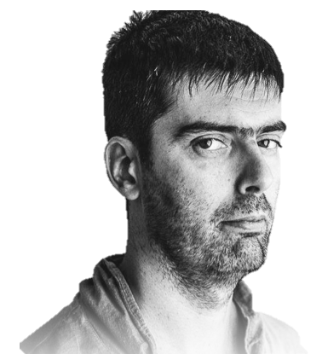

About Tamás
Tamás Földi
CTO and Partner, Starschema
Co-Founder and Partner at Starschema
Tableau Zen Master for the fourth consecutive year

Slide 5

About Kristóf
Dr Kristóf Cséfalvay
VP Special Projects, Starschema
Originally trained in law, then in clinical epidemiology
10-year track record of data science jobs, including at companies like Volkswagen AG, RB plc and various roles in public service
Special interest in neural networks/deep learning, geospatial analytics and data exploration
Joined Starschema as Principal Data Scientist, currently serving as VP Special Projects

Slide 6
Drug adverse event monitoring with Tableau

Slide 7
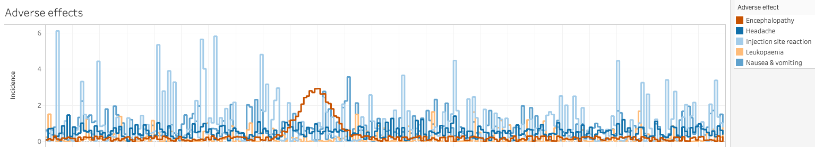
Drug adverse event monitoring with Tableau
Typically, patients taking a medication may exhibit a range of side effects.
These typically exhibit three patterns over time:
Uniform: occur regardless of treatment duration with a relatively constant frequency
Accumulative: occur with increasing risk as the duration of treatment progresses
Spike events: in an insolated group of patients, these events occur after a certain amount of time.
Identifying spike events (in this case, encephalopathy) can assist in tailoring maximum treatment duration and avoiding ADRs.

Slide 8
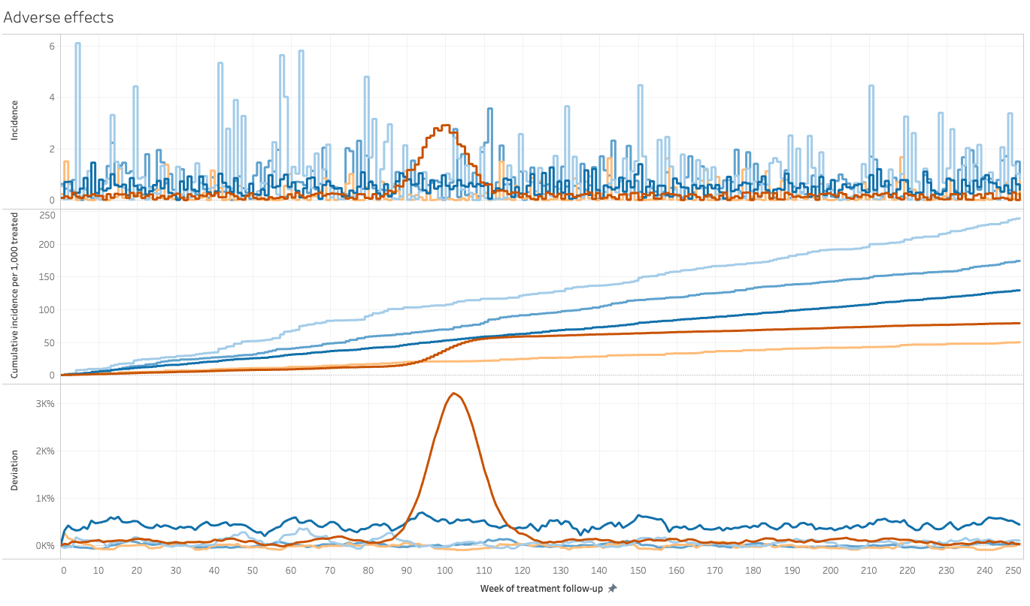
Indication of anomalous behaviour

Slide 9
COVID-19: a tale of three states

Slide 10
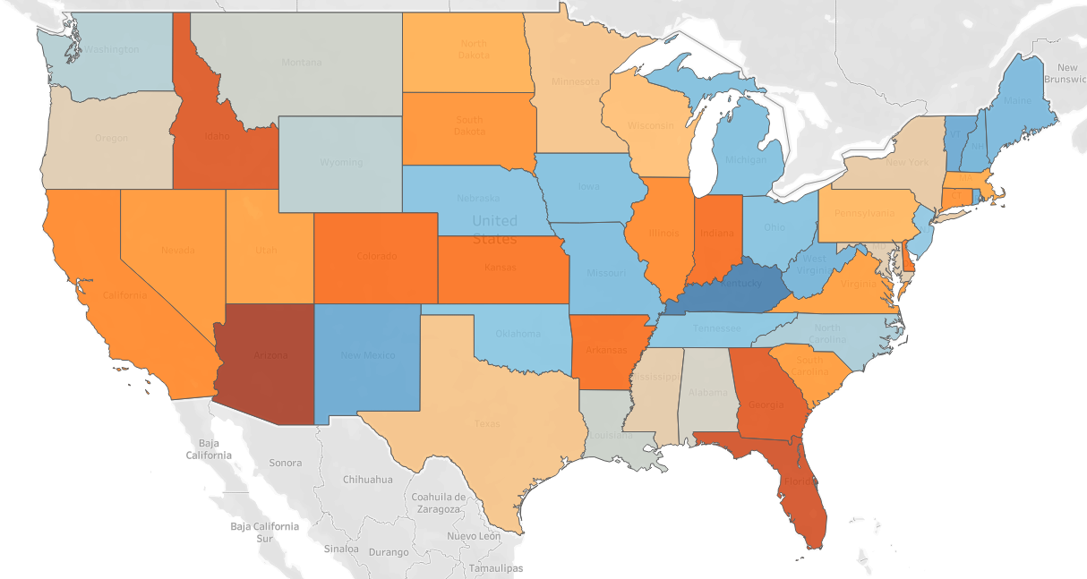
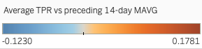
COVID-19: a tale of three states
Populations have responded differently to the COVID-19 pandemic. Spatial analysis in Tableau can help in the analysis of approaches to managing the pandemic.
By analysing test positivity ratios (positive tests as fraction of all tests conducted), we can identify various patterns of disease dynamics, and extrapolate future outcomes.
We can then cross-correlate this with changes in mobility characteristics of the underlying population.
Tableau makes it convenient to display and analyse this data dynamically.

Slide 11
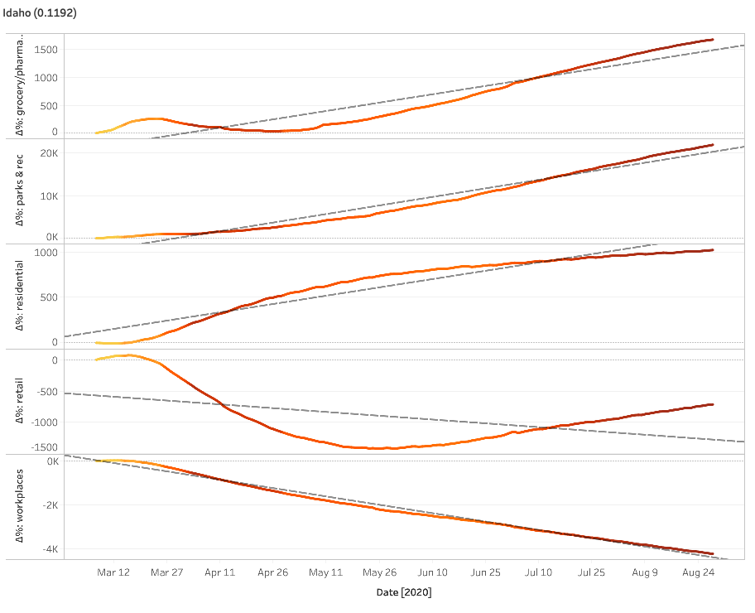
COVID-19: a tale of three states
Some states, such as Idaho (see left), have enacted relatively modest measures of social distancing.
While workplaces remain largely less visited and retail is significantly less than it was in early March, grocery/pharmacy visits and visits to parks and recreational facilities has rebounded.
As a consequence, as the colour of the line indicates (darker = higher test positivity ratio), test positivity ratios have increased.

Slide 12
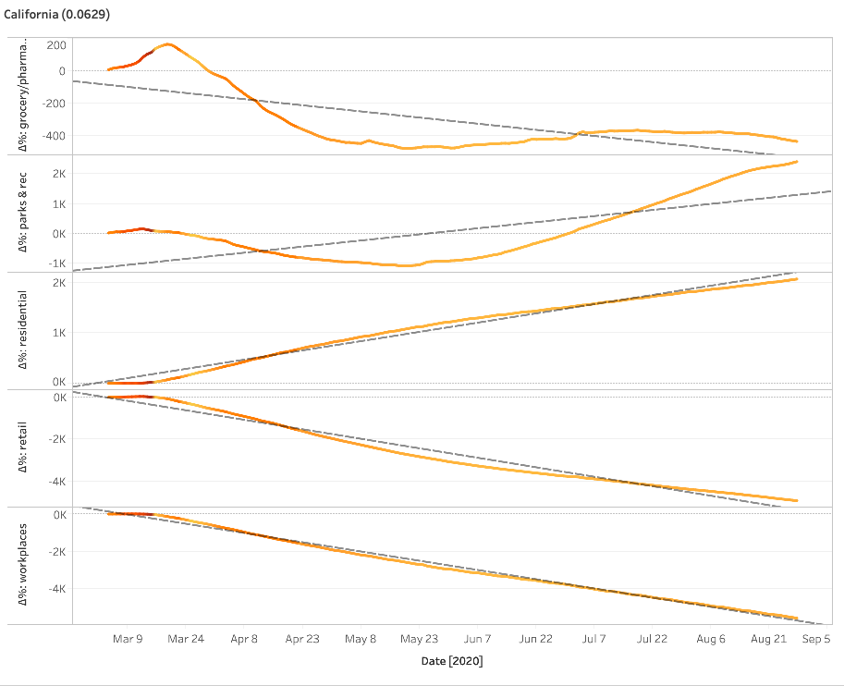
COVID-19: a tale of three states
California (see left) is an example of an early case of effective strict management: a strong reduction in retail and workplaces has led to a relatively low case positivity ratio.
The effect of early quarantines (March-April) is particularly visible: residental attendance (stay-at-home) increases while retail, workplaces and grocery/pharmacy related mobility drop sharply. By late April/early May, the effects of this are visible as a decrease in test positivity ratios.

Slide 13
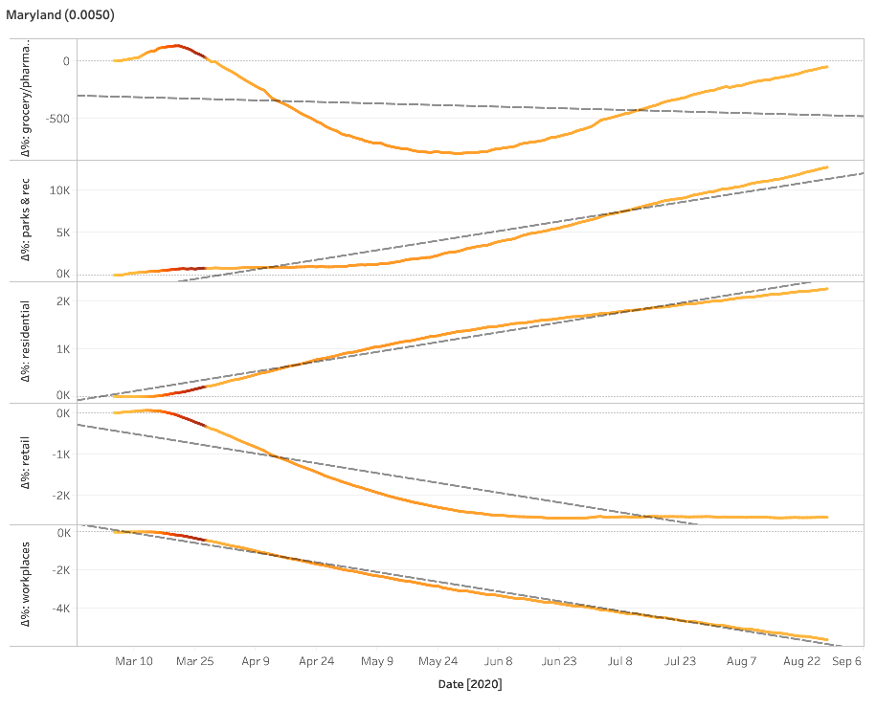
COVID-19: a tale of three states
In Maryland, early high test positivity ratios in March have led to rapid decreases.
By late May, the test positivity ratio has decreased, and by July, a bounce-back has started, especially for the grocery/pharmacy sector.
Around the same time, the decline of retail attendance flattened and residential attendance began to slowly taper off.

Slide 14
Time series forecasting in Tableau

Slide 15
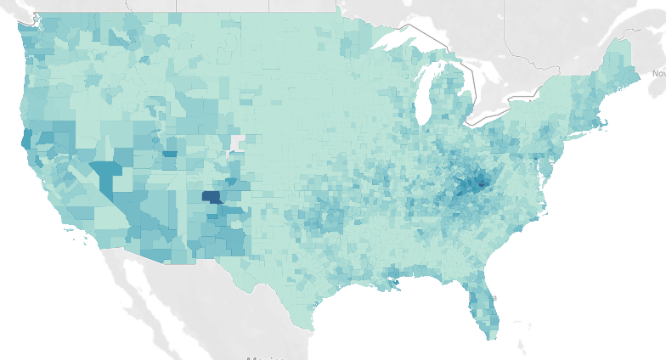
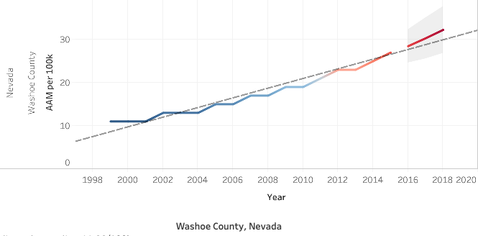
Time series forecasting in Tableau
Tableau's built-in time series forecasting capabilities can create forecasts from time series based on a linear model.
This visualisation shows a county-level breakdown of age-adjusted mortality from drug poisoning, 1998-2015, based on data from the CDC's National Center for Health Statistics, per 100k age-adjusted normal population.
In the inlay, data to 2015 is extrapolated to yield a forecast from 2016 onwards by fitting a linear model.

Slide 16
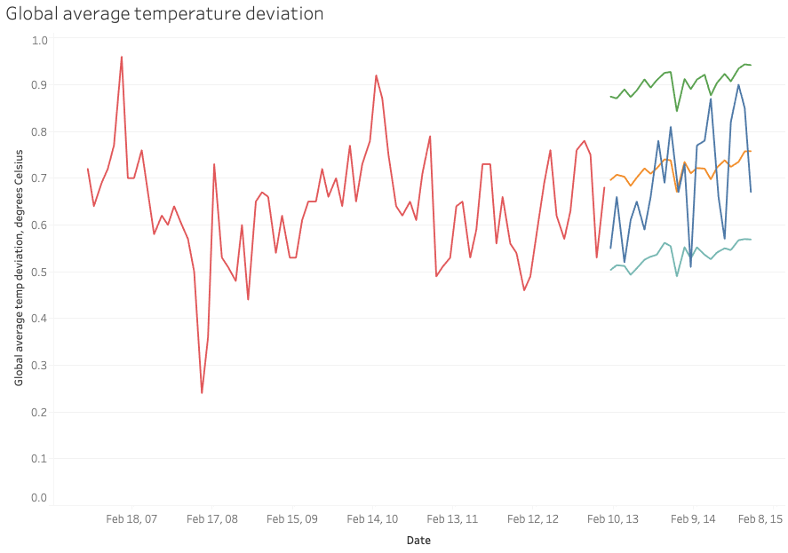
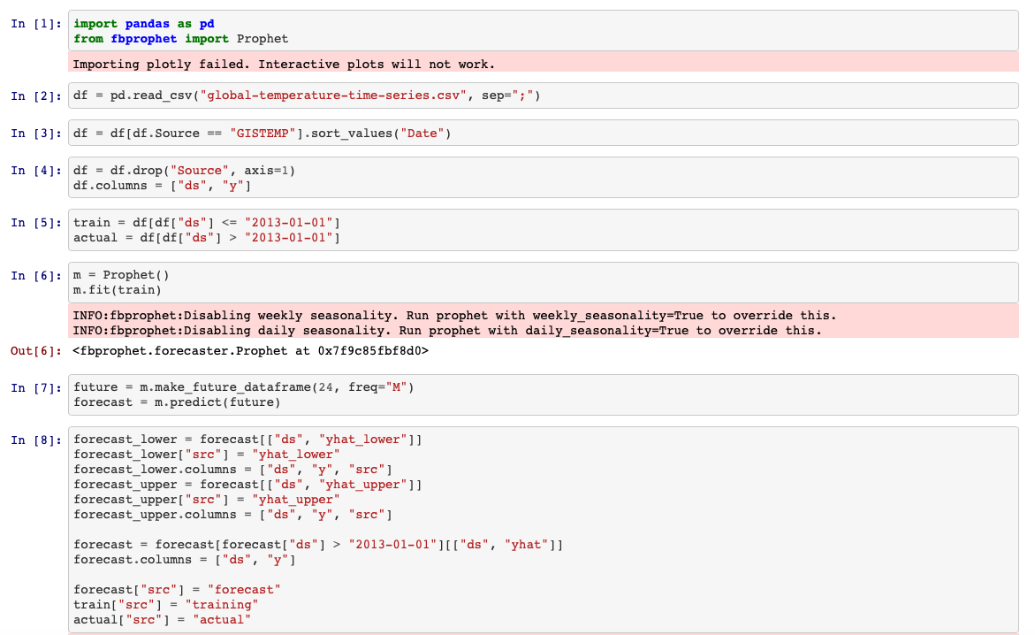
Time series forecasting in Tableau
In addition, Tableau can also visualize forecasts from external tools.
In this case, Prophet was used via Python (see inset) to forecast the global average temperature deviation based on meteorological data from 1880 to 2013.
Actual values are displayed for the forecast period in blue, with the forecast value displayed in orange and the 95% confidence interval, based on a linear model, in green and teal.

Slide 17
Performance mining of pharmaceuticals

Slide 18
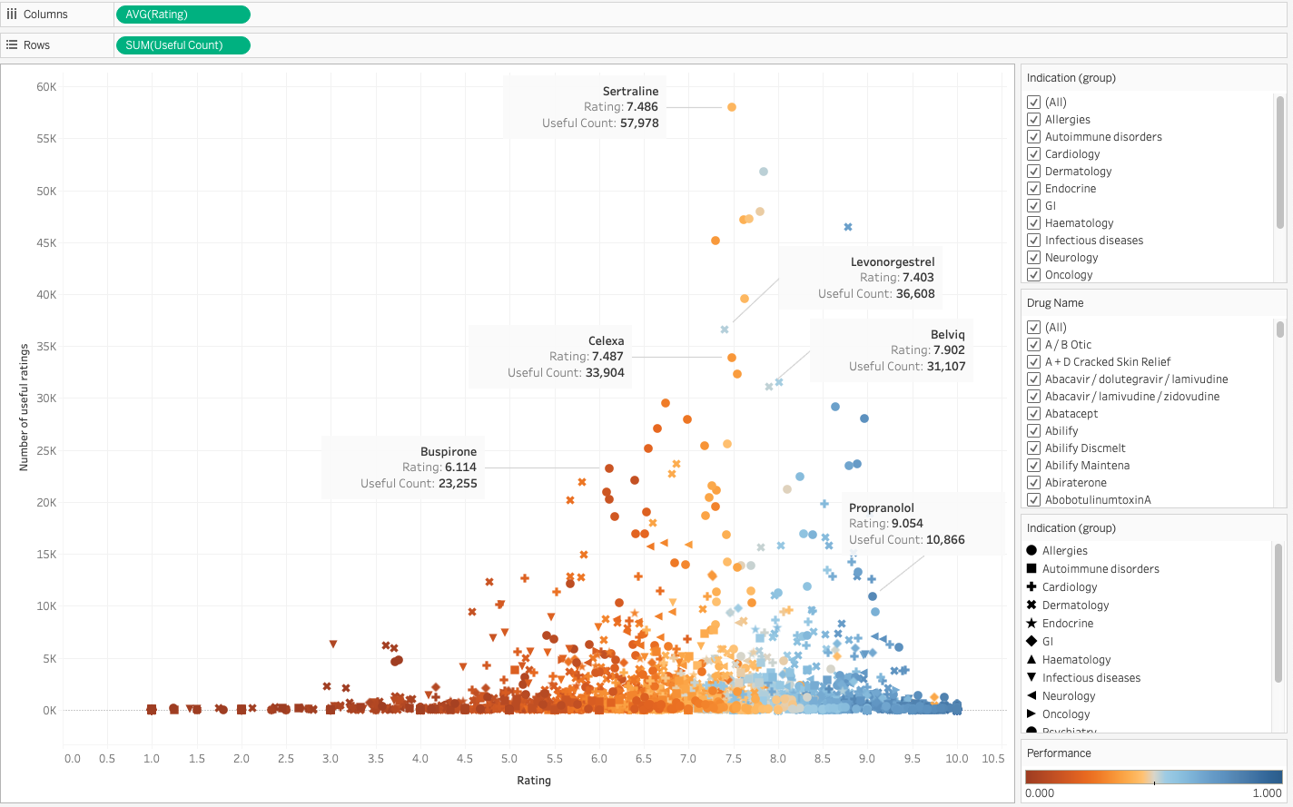
Performance mining of pharmaceuticals
Tableau's new analytical capabilities allow for regression analyses by calculating the posterior predictive probability function of a particular value.
In this use case, we are using reviews of prescription medications from drugs.com by customers to identify
underperformers: drugs that are rated highly by patients (e.g. due to a neutral adverse effect profile), but are found by fewer than expected to be effective
overperformers: drugs that are found effective by relatively more patients than could be expected based on the rating (e.g. due to unfavourable adverse effect profiles)

Slide 19
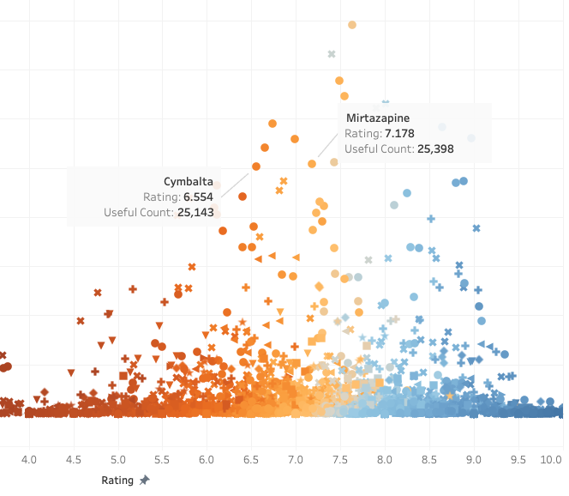
Performance mining of pharmaceuticals
For instance, we can compare the relative performance of two pharmaceuticals – mirtazapine is much higher rated than duloxetine (Cymbalta), but has roughly the same number of patients who have responded to it.
This allows us to estimate and quantify the relative performance of pharmaceuticals, including a quantification of how well a drug is tolerated (patient ratings give a good practical indication of ADR profile and tolerability).

Slide 20
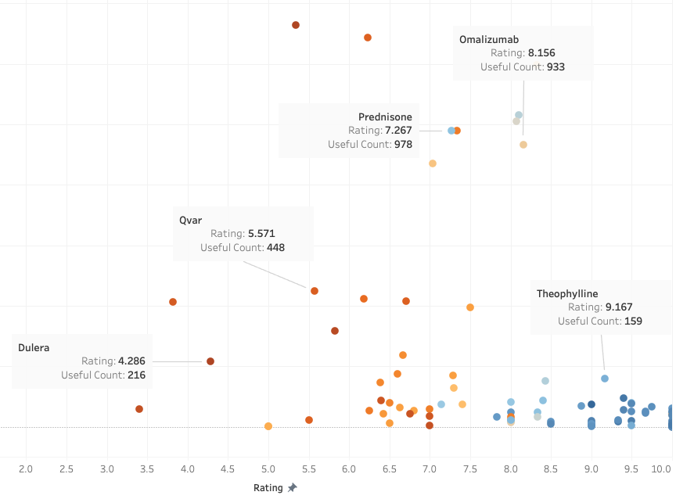
Performance mining of pharmaceuticals
In addition, this allows for the comparison of category-wise utilisations (e.g. all drugs with an indication for maintenance treatment in asthma, see left).
This helps to see some fundamental performance differences: in particular, omalizumab (Xolair), despite the burden of administration by subcutaneous injection, significantly outperforms prednisone.
This type of analysis can make a compelling quantitative case for a more expensive medication to payers/insurers.

Slide 21
Thank you
tfoldi@starschema.com
csefalvayk@starschema.com

